Slide 1
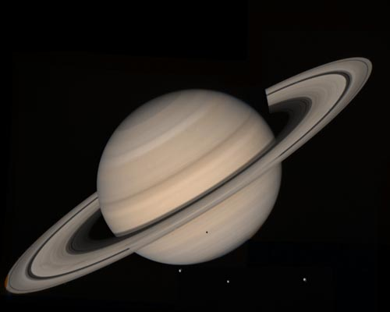
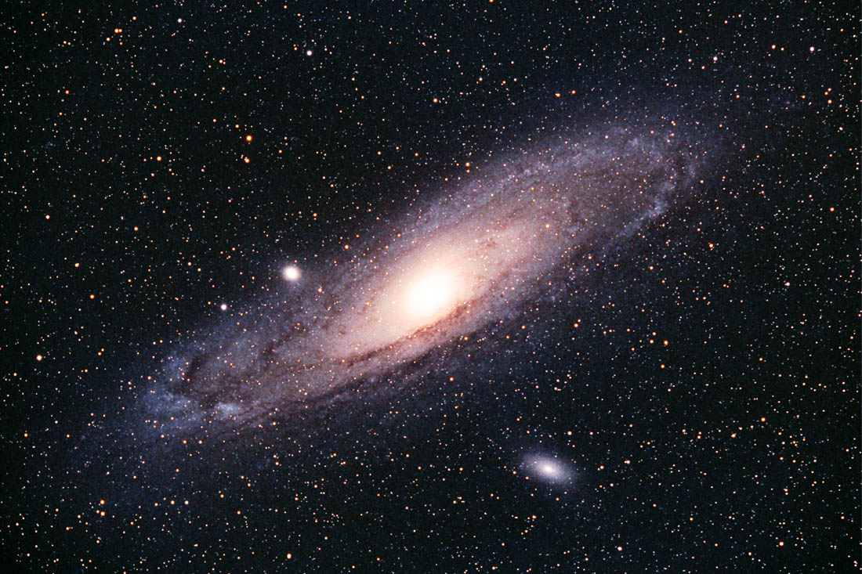

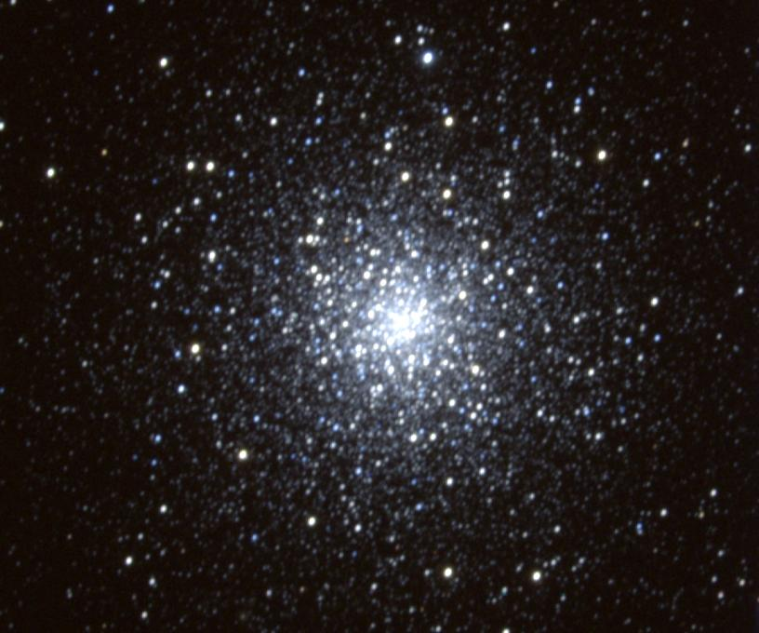
Black Holes in Space
Mizar

Slide 2
Mizar (Zeta Ursae Majoris) Through the Telescope
Zeta Ursae Majoris is more commonly known as Mizar.
When seen through the telescope, Mizar turns out to be not one, but two stars. They are called A and B

Slide 3
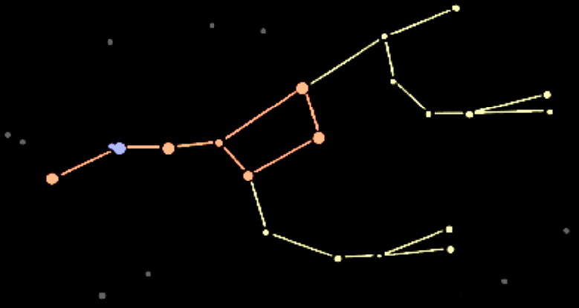
Mizar In The Night Sky
Mizar is the middle star of the handle of the Big Dipper, which is actually part of the constellation Ursa Major, the Great Bear.
Big Dipper
Ursa Major
Mizar

Slide 4

Mizar In The Night Sky
If you look closely at the Big Dipper you can see that Mizar has a near-by companion called Alcor.
Alcor
Mizar
The ability to spot Alcor was traditionally used as an eye test!

Slide 5

Mizar (aka Zeta Ursae Majoris) & Alcor
Mizar and Alcor form a wide trio of stars.
Alcor
Mizar A & B

Slide 6
Binary or Multiple Stars
Mizar A & B are 78 light years from Earth, separated by 47 billion miles, and orbit each other every 5,000 years.
This makes Mizar A & B a binary star system.

Slide 7
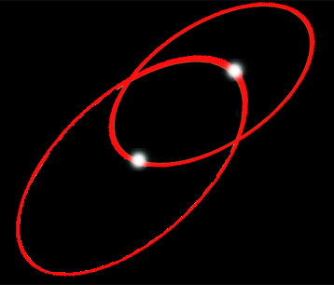

Mizar - Multiple Stars
Mizar A & B are each multiple stars. They have dim binary companions.
Mizar Aa Ab
Mizar Ba Bb
So, Mizar is actually a 4-star system.

Slide 8
Mizar - Multiple Stars
Mizar Ba and Bb are about 280 million miles apart and orbit each other every
57 years.
Mizar Aa Ab
Mizar Ba Bb
Mizar Aa and Ab are 28 million miles apart and orbit each other every 20 days.

Slide 9

Multiple-Double
The Mizar system and Alcor are about 3 light years apart. So they are close neighbors but not orbiting each other.
Thus, Mizar-Alcor is a 4 star system and an optical double.

Slide 10
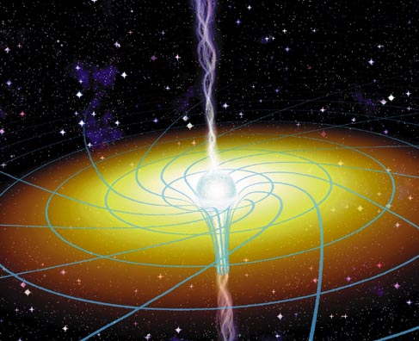
Black Holes
A black hole is an object with such strong gravity that in order to escape it you would have to travel faster than the speed of light (186,000 mi / sec).
Since nothing can travel that fast, even light itself can never escape a Black Hole.

Slide 11
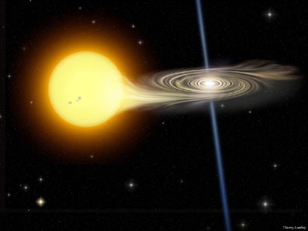
X-Ray Sources in Space
The first step in finding black holes is to look for a source
of X-rays in space.
Sometimes the X-ray
source is associated
with what appears to be a single ordinary star. But, wait a minute … “ordinary” stars do not emit X-rays.

Slide 12
X-Ray Sources in Space
Closer examination of the star may reveal an “unseen” companion. Further study
then reveals the distance between the objects, the
length of time they take
to orbit each other and the
mass of the unseen companion.

Slide 13
X-Ray Sources in Space
If the calculated mass of the unseen companion is greater than about 3 solar masses,
it must be a black hole.
The X-rays are produced
by material falling into the
black hole and being heated
to over 2 million degrees.

Slide 14
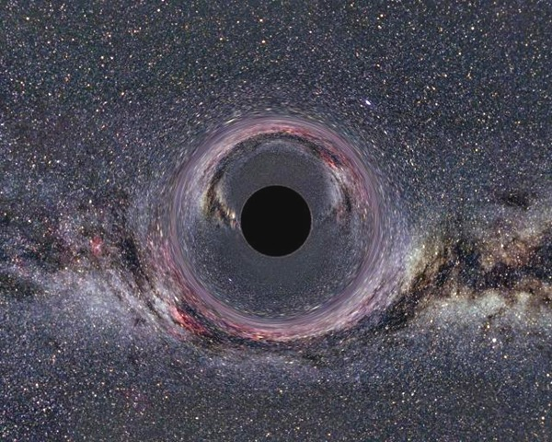
Evidence of Black Holes
Not all black holes exist in binary systems. Lone stellar-mass black holes do not have gas falling into them, and will not emit x-rays. Without the x-ray emission, they are very difficult to detect.

